Slide 1

Cypurr Sessions
Man-In-The-Middle and Me!
November 26, 2017
Notes:
“La ingeniería de eq de fases comprende la aplicación del conocimiento fenomenológico del comportamiento de sistemas homogéneos y multifásicos, y su predicción mediante herramientas termodinámicas, con la finalidad de contribuir al desarrollo de procesos químicos. El diseño del equilibrio de fases es un nexo entre los requerimiento de un dado proceso y las actividades académicas de medición y modelado de datos experimentales.
[…] Esta disponibilidad (de simuladores computacionales) hace necesario estudiarla, con la finalidad de alcanzar un uso más fehaciente y efectivo de éstos, a través del desarrollo de criterios generales que faciliten la comprensión del potencial y limitaciones del proceso químico.”
Pereda, tesis doctoral, PLAPIQUI/UNS 2003, pp 4.1.

Slide 2
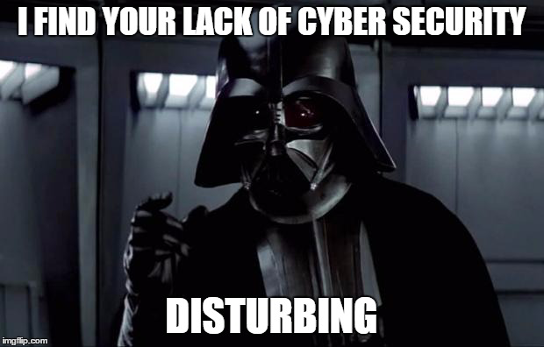
WELCOME!

Slide 3
Outline
Introduction
Rules n’ Such
Current Events
ENCRYPTION GAME!
Man In The Middle/Mini Workshops
Tor/VPN 101
Safe Browsing and YOU!
Thank You/Resources
Notes:
Ability concerns contact
Assisting with needs
Breaks
“Can everyone see [me/ the board/ the screen/ the main point of focus]?”
“Can everyone hear me at this volume? Am I speaking at a good pace?”
New words/phrases

Slide 4
Who are we? Who are you?
We are the…
The Cypurr Collective: A group of folks that organize cybersecurity workshops and socials, looking to spread knowledge and talk about privacy rights!
...and you are?
Name
Pronouns (i.e. he/him, she/her, they/them, ze/zer, etc)
In a few words, what brings you here today?

Slide 5

A few rules for this workshop …
Share the space!
Step Up Step Back: Ask a question, give a comment, leave room for others to speak
Stack!
Raise your hand and we will put you on the speaking queue
Saf(er) Space
We DO NOT tolerate language or behavior purposefully meant to demean or harm folks based on their identities
No one should be forced to discuss their own experience/threat model/situation
Consent: Ask before helping someone out, before taking their device
Photo/Video- No photo/video without asking!
Bonus Rule: Try not to invalidate experiences!

Slide 6
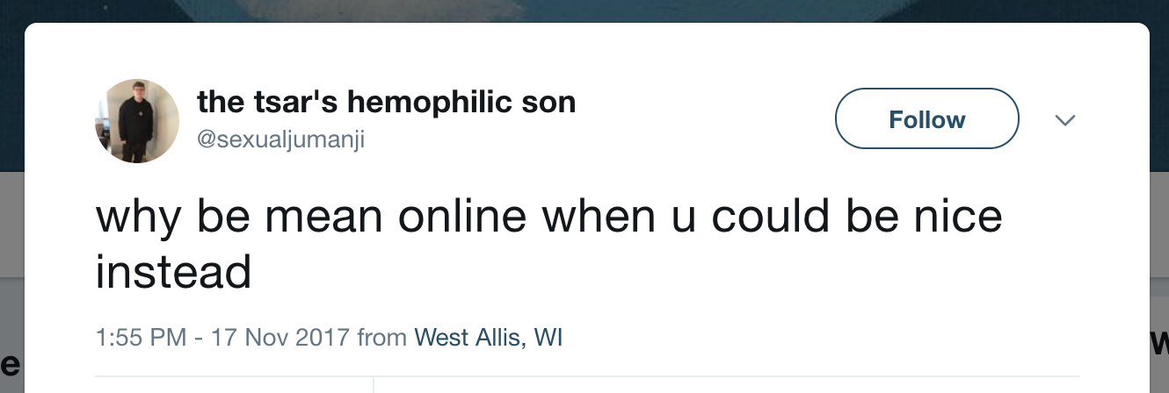
Current Events!

Slide 7

WHAT’S ON YOUR MIND?

Slide 8
Story #1: Tiers for Fears
Ajit Pai, FCC, and Net Neutrality
November 21st

Slide 9
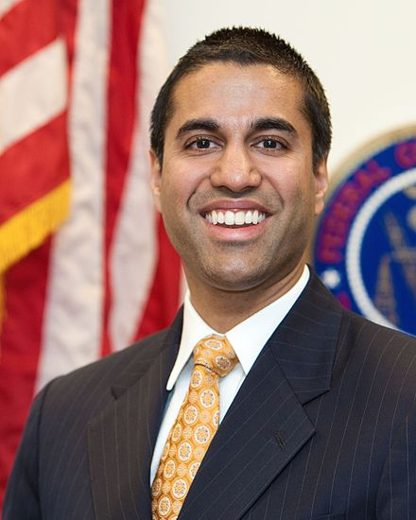
The Story?
This past week, the Chairman of the FCC, Ajit Pai, announced a proposal that would begin the reversal of net neutrality rules established under the Obama administration
With the prediction that FCC members will vote by party lines, analyst say the December 14th vote will reverse these rules, 3-2

Slide 10
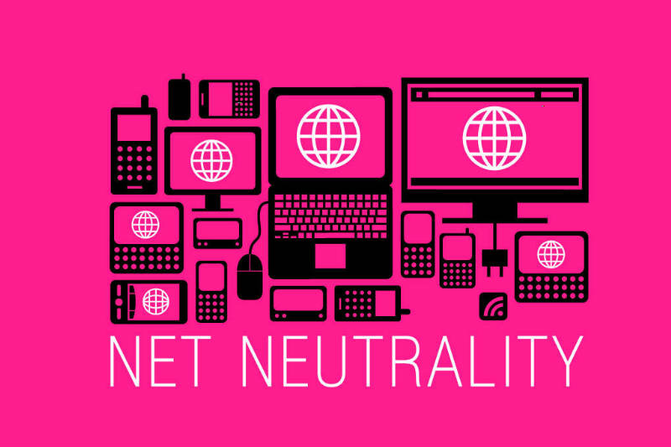
The Threat?
ISP have more control over distribution of content
Censorship
Higher Prices
Pay to Play
“...the rules prohibit Internet providers from blocking, throttling, and paid prioritization—"fast lanes" for sites that pay, and slow lanes for everyone else.”

Slide 11
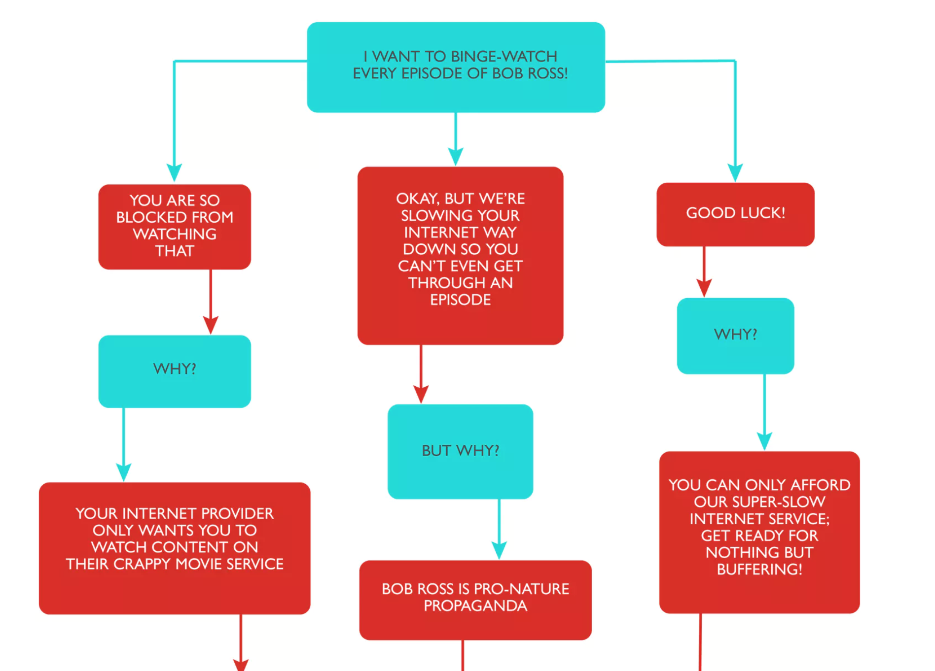

Slide 12
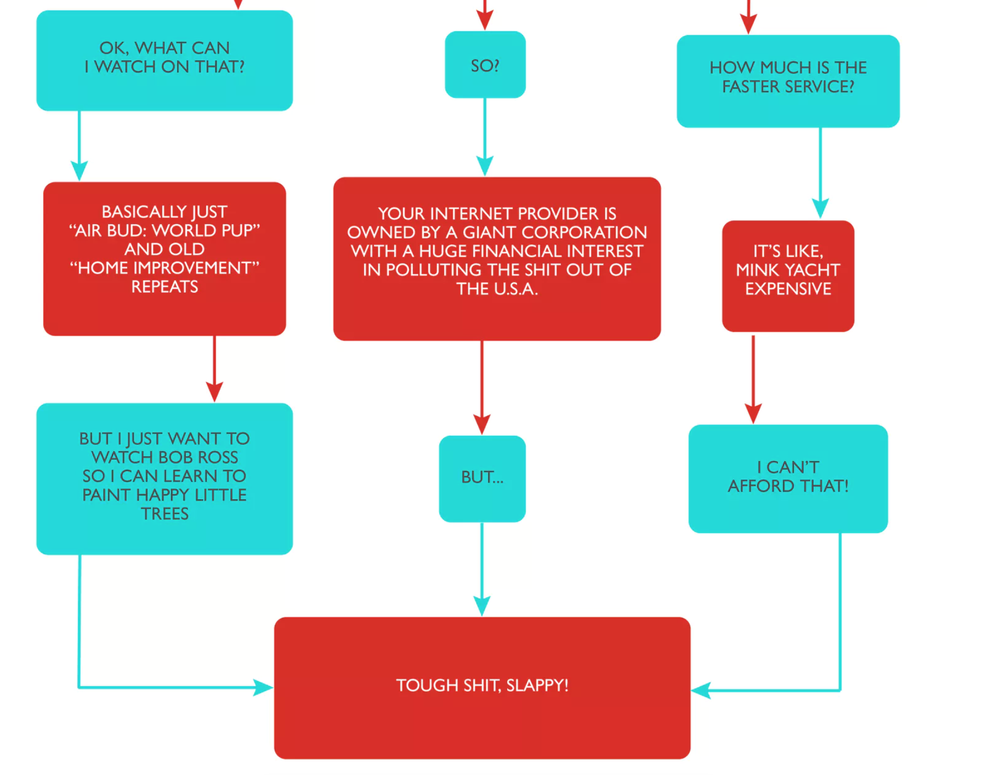

Slide 13
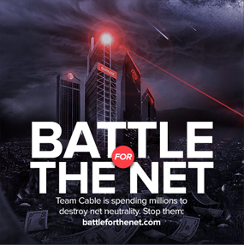
What To Do?
Check out www.battleforthenet.com/ for more info!
Comment on FCC.gov!
Teach yourself, teach a friend!

Slide 14
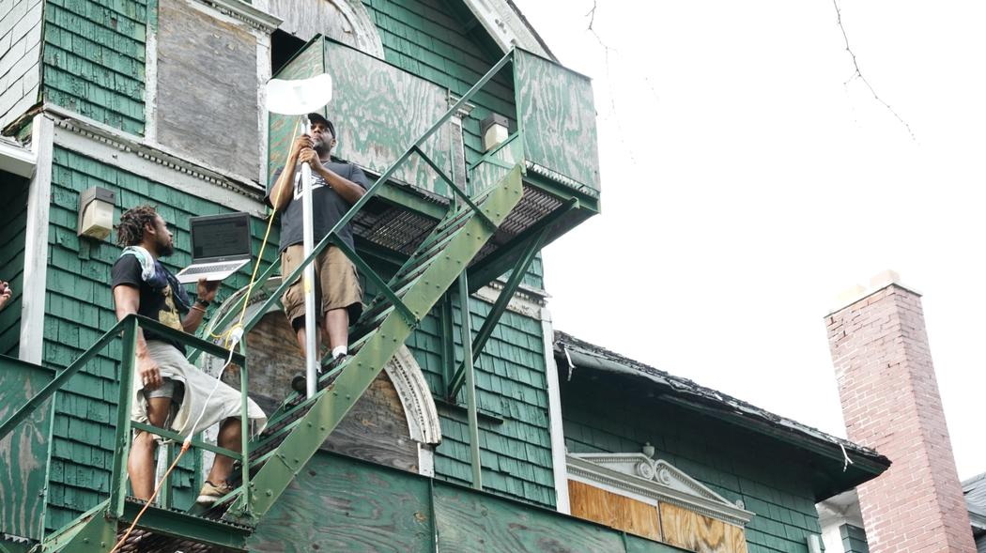
Story #2: DIY Internet
Ignored By Big Telecom, Detroit's Marginalized Communities Are Building Their Own Internet
Motherboard, November 16th

Slide 15
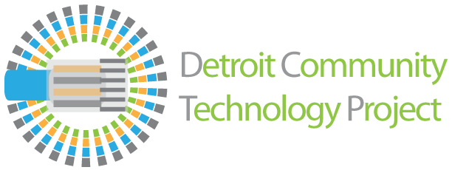
The Story?
“40 percent of Detroit residents don't have any access to internet at all.”
“Because of Detroit’s economic woes, many Big Telecom companies haven’t thought it worthwhile to invest in expanding their network to these communities”
Local group, The Detroit Community Technology Project, is teaching local commuity members how to create their own Mesh networks for low-income folks

Slide 16
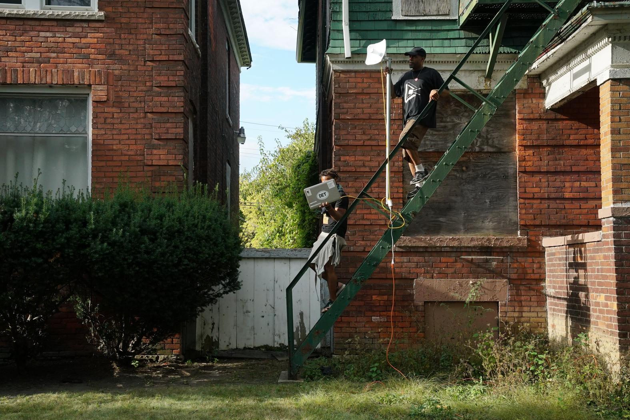
Why?
Internet is a vital modern need
Mesh networks allow for internet access, through the installation of nodes/supernodes, without the ISP acting as intermediary
“In a city that is rebuilding after a decade of economic turmoil, the internet can no longer be a luxury for the wealthy...All of Detroit (or, certainly, more than 60 percent) needs access to the internet and the current structure established by Big Telecom hasn’t made this an easy goal. “

Slide 17
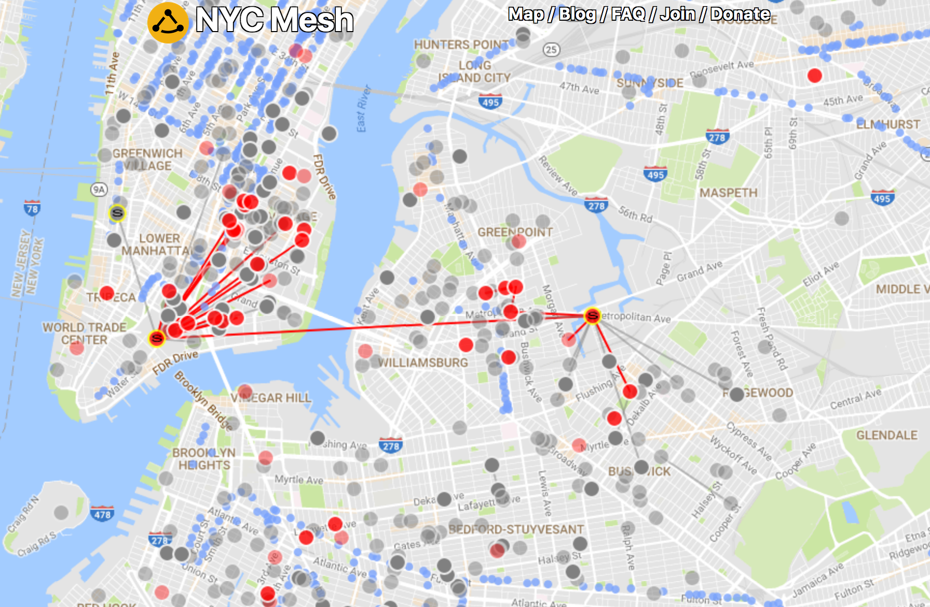

What to do?
Spread the word about the Equitable Internet Initiative
Check out similar local efforts!
NYC Mesh
Red Hook Wifi

Slide 18
STRETCH BREAK

Slide 19
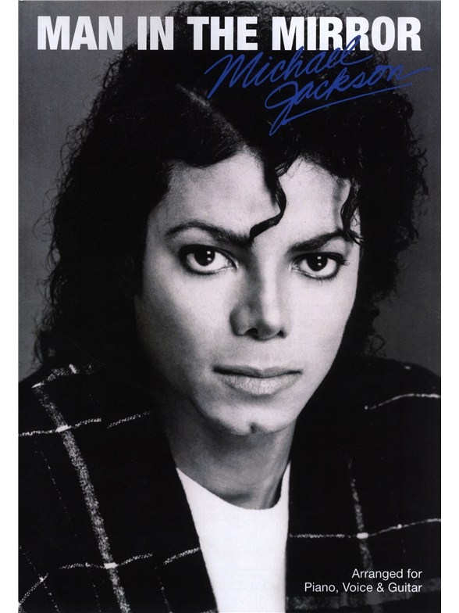
Man-in-The-Middle and Me!
MIDDLE

Slide 20
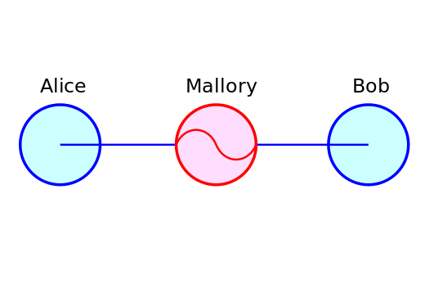
Man-In-The-Middle….?
“A Man-in-the-middle attack is where a malicious individual intercepts your communications and pretends to be your intended destination. This individual will see all your traffic before handing it off to your intended target. MITM spoofs an authentic website in order to violate your confidentiality.”
How does it happen?

Slide 21
ENCRYPTION GAME!

Slide 22
Mini Workshops!
Intro to Tor/VPN
Safe Browsing and You!
Extensions
Online App Alternatives

Slide 23
Thank You and Resources
CyPurr Collective on Facebook for Future events!
Sign up to our email list too, we won’t spam ya!
Current Events Resources
BattlefortheNet.com
Ignored By Big Telecom, Detroit's Marginalized Communities Are Building Their Own Internet, Motherboard November 16, 2017
NYCMesh.Net
RedhookWifi.org

Slide 24
Thank You and Resources
Further Resources
NYC CryptoParty Meetup/CryptoParty Harlem (Meetup)
HacbBlossom (Hackblossom.org)
Tactical Tech Collective-
Holistic Security,
MyShadow
Data Detox
EFF- Surveillance Self Defense (ssd.eff.org)
Freedom of the Press Foundation (Freedom.press)
AnarchoTech Collective- Ridgewood, NYC

Slide 25

See you next time!

